Slide 1
BIG Data Overview
Dr. Achmad Solichin | Universitas Budi Luhur
Adopted and updated from slide by Desai Karan A
https://in.linkedin.com/in/karan28

Slide 2
1 Handy Hands-On

Slide 3
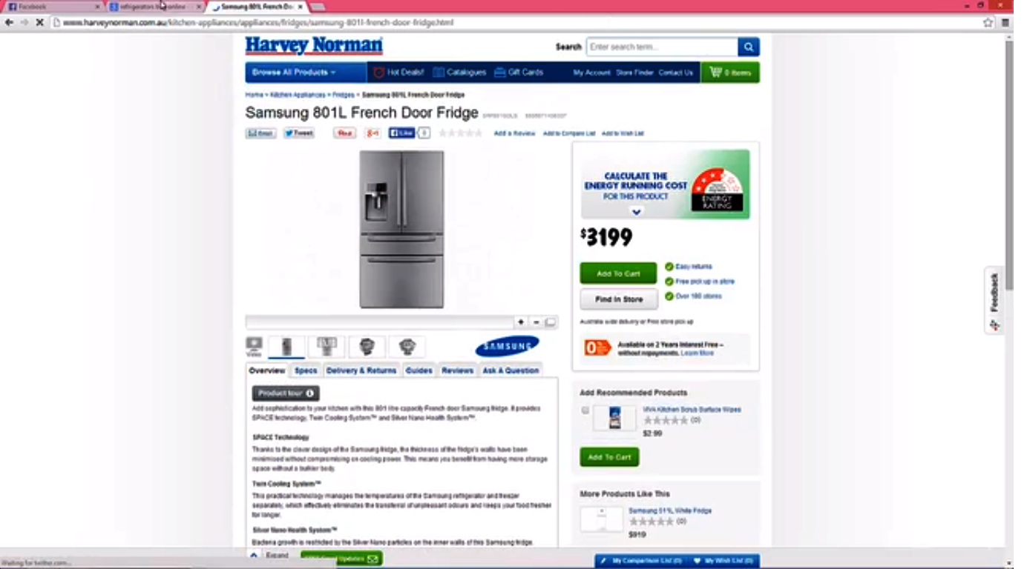

Slide 4


Slide 5
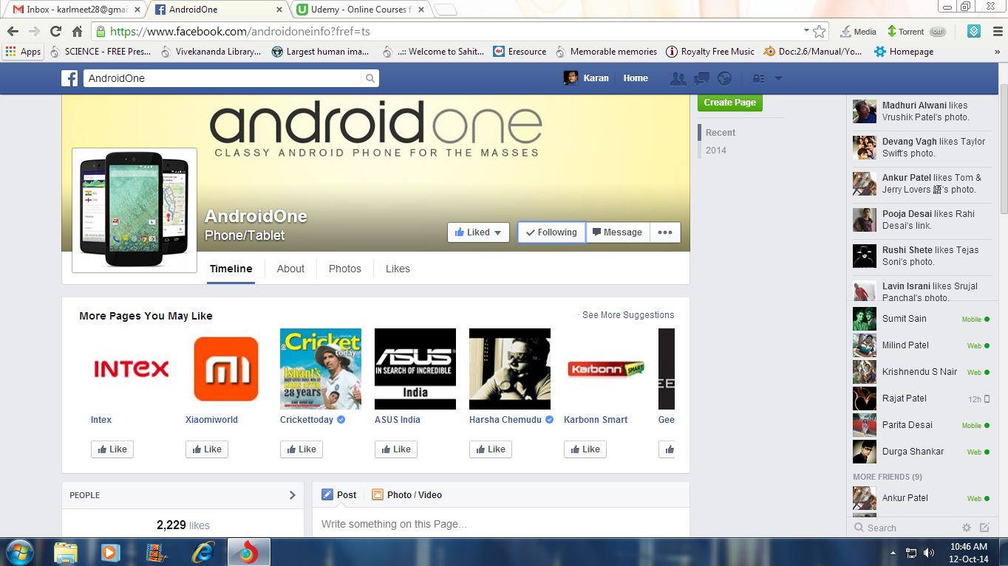

Slide 6
2. Introduction to big data
-2.1 What is big data?
-2.2 Etymology.
-2.3 Hype and Facts.

Slide 7
2.1 What is big data?
“Big data” refers to datasets whose size is beyond the ability of typical database software tools to capture, store, manage, and analyze.
Big Data is the extremely large data sets that may be analyzed computationally to reveal patterns, trends, and associations, especially relating to human behavior and interactions.
Big data is the data of range more than 1000 gigabytes or 100 zettabytes.

Slide 8

2.2 Etymology: Word Origination
BIG DATA
John R Mashey, chief scientist at Silicon Graphics coined the term “Big Data”.
Big data is the simplest, shortest phrase to convey that the boundaries of computing keep advancing, growing, diversifying and intensifying rapidly..

Slide 9

2.3 Hype and Facts
The world’s data is doubling every 1.2 years

Slide 10
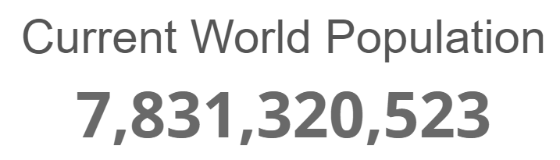
2.3 Hype and Facts
Sumber: https://www.worldometers.info/world-population/

Slide 11

2.3 Hype and Facts: In one second…
9.255 Tweets sent
1.036 Instagram photos uploaded
1.804 Tumblr posts
5.194 Skype calls
106.378 GB of Internet traffic
87.956 Google searches
87.187 YouTube videos viewed
2.976.306 Emails sent (~67% spam)
Sumber: https://www.internetlivestats.com

Slide 12
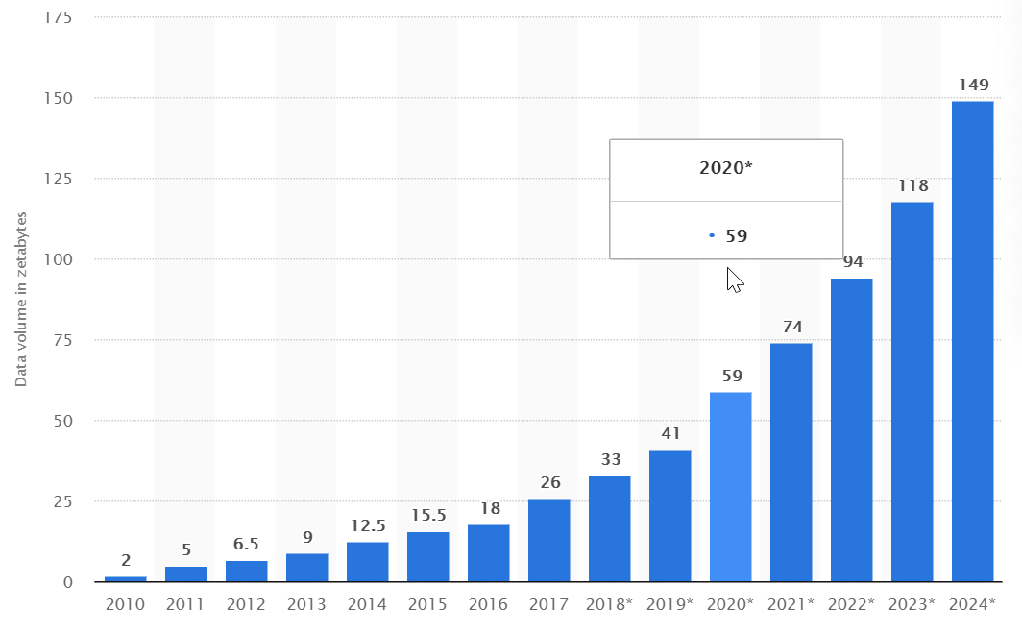
2.3 Hype and Facts
We generate 2.5 QUINTILION BYTES EVERYDAY
In 2020, the world’s data/information ~59 zettabytes
Sumber: https://www.statista.com/statistics/871513/worldwide-data-created/

Slide 13
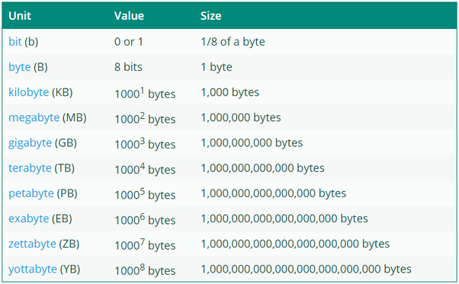
2.3 Hype and Facts

Slide 14
3. Big Data Niceties.
-3.1 Evolution of Big Data
-3.2 Why traditional tools fail?

Slide 15







3.1 Evolution Story:

Slide 16
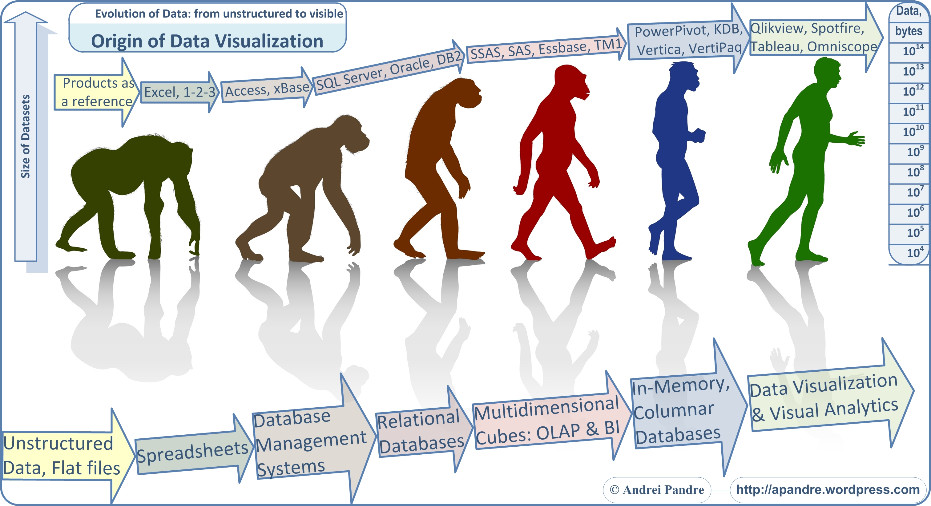
Notes:
SSAS: SQL Server Analysis Services, SSAS, is an online analytical processing (OLAP), data mining and reporting tool in Microsoft SQL Server.
Essbase is a multidimensional database management system (MDBMS) that provides a multidimensional database platform upon which to build analytic applications.
BM Cognos TM1 (formerly Applix TM1) is enterprise planning software used to implement collaborative planning, budgeting and forecasting solutions, as well as analytical and reporting applications.
Power Pivot is a free add-in to the 2010 version of the spreadsheet application Microsoft Excel. PowerPivot workbooks are self contained web applications, merely requiring a 'Save as' to make them accessible in the browser as interactive solutions.”.
K is a proprietary array processing language developed by Arthur Whitney and commercialized by Kx Systems. Since then, an open-source implementation known as Kona has also been developed. ... kdb is both a database (kdb) and a vector language (q). It's used by almost every major financial institution
Vertica Systems is an analytic database management software company.
QlikView is the most flexible Business Intelligence platform for turning data into knowledge.
TIBCO Spotfire® designs, develops and distributes in-memory analytics software for next generation business intelligence.
Tableau Software is an American computer software company headquartered in Seattle, Washington. It produces a family of interactive data visualization products focused on business intelligence
Omniscope is single, in-memory, file-based application that enables agile, 'best practise' data sharing solutions
An in-memory database (IMDB; also main memory database system or MMDB or memory resident database) is a database management system that primarily relies on main memory for computer data storage. It is contrasted with database management systems that employ a disk storage mechanism.
Relational databases are row oriented, as the data in each row of a table is stored together. In a columnar, or column-oriented database, the data is stored across rows.

Slide 17


3.2 Why traditional tools fail? (contd.)
E-TSUNAMI and Heavy RAINS of DATA…

Slide 18

3.2 Why traditional tools fail?
The present data is highly BIG for the traditional data managers.
Can work only with small samples of data
It is same as looking through keyhole and finding size of room…

Slide 19
4. Specifics of Big Data
-4.1 Characteristics
-4.2 Life cycle

Slide 20
4.1 Characteristics
Big data
Volume
Variety
Velocity
Veracity

Slide 21
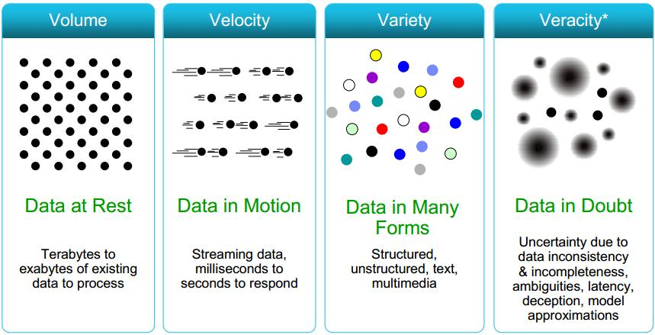

Slide 22
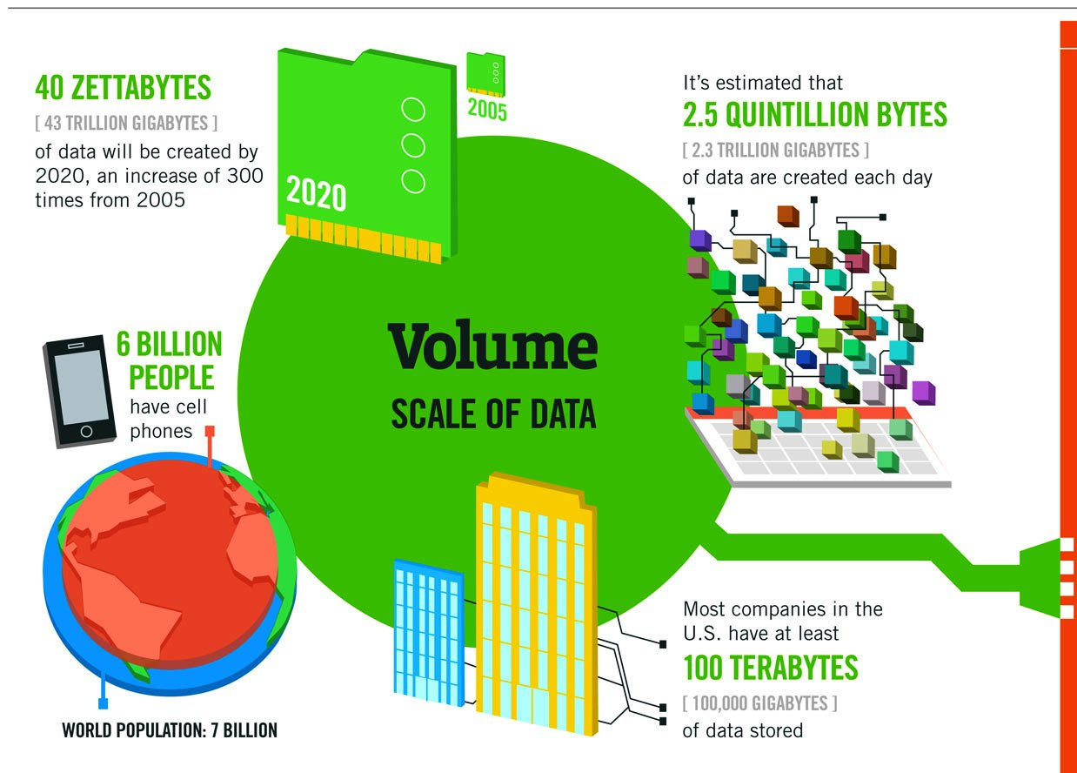

Slide 23
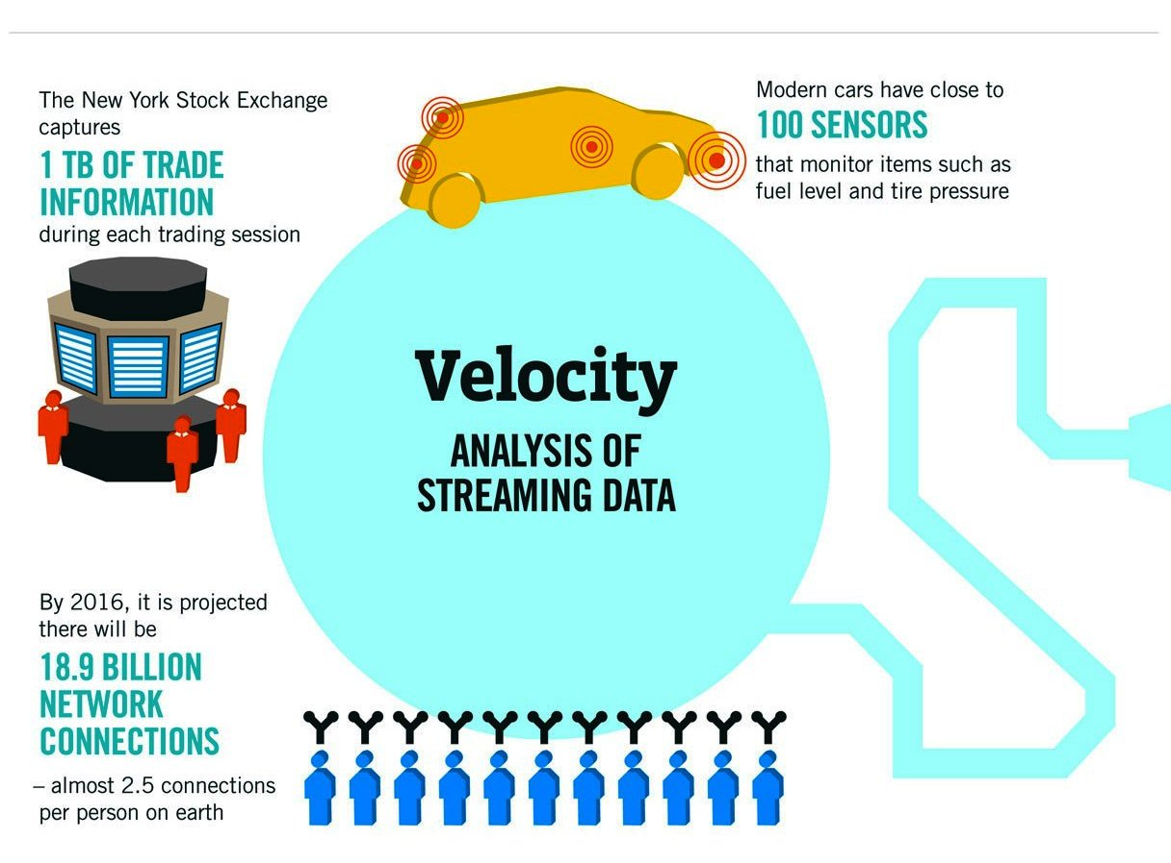

Slide 24
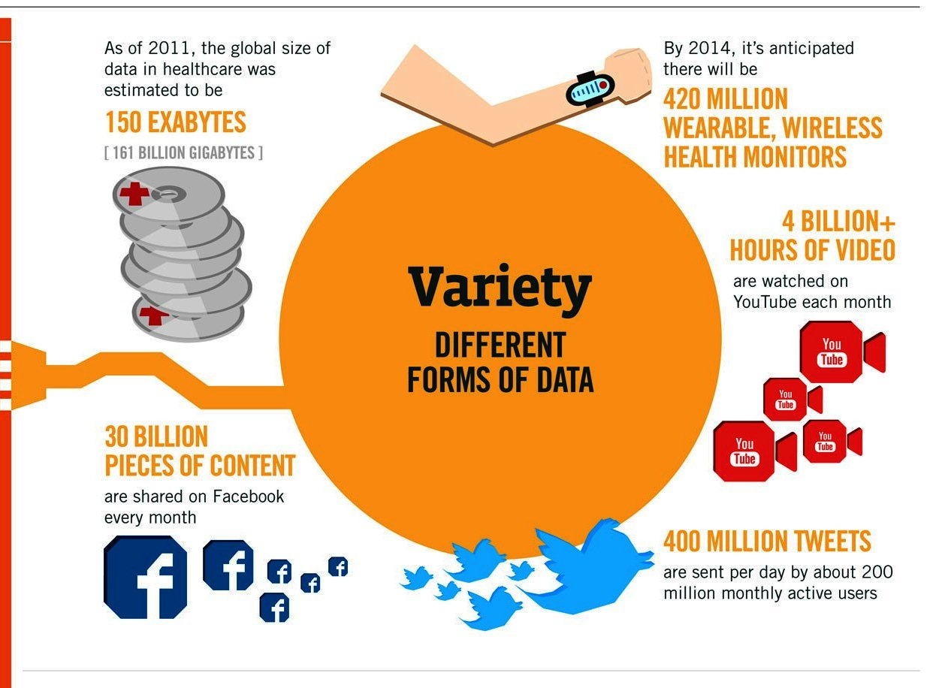

Slide 25
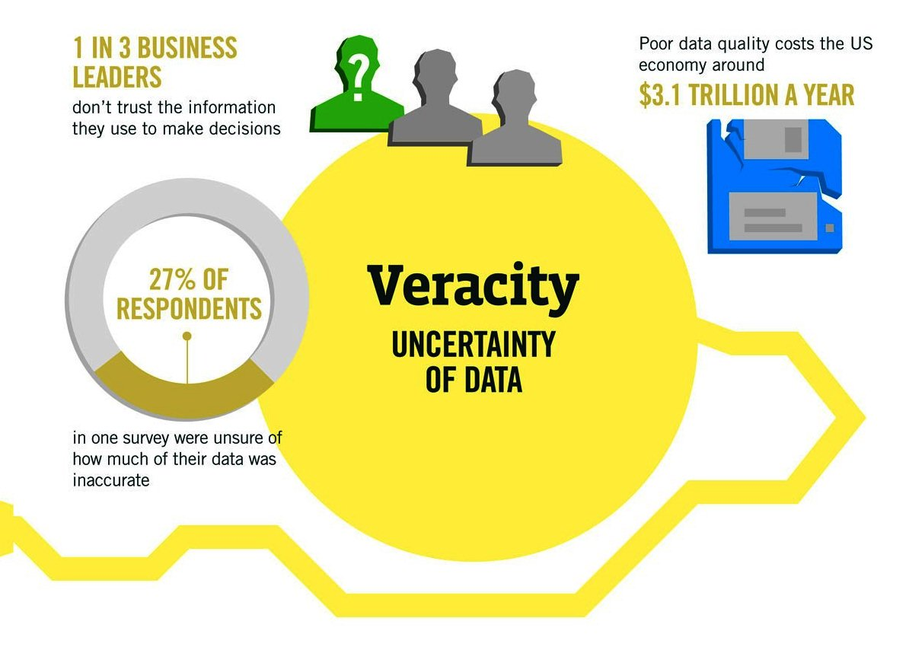

Slide 26
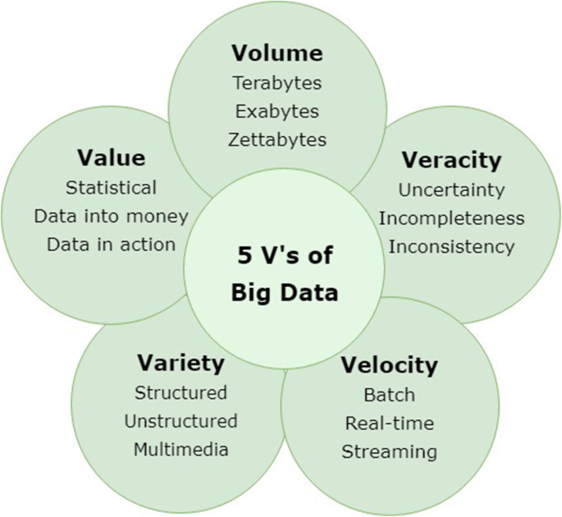
Another views…
Sumber: https://journalofbigdata.springeropen.com/articles/10.1186/s40537-019-0206-3

Slide 27
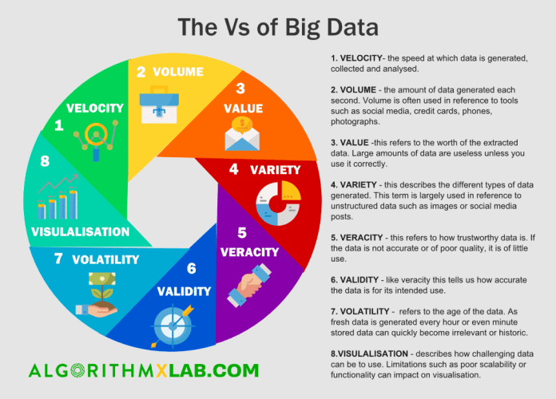
Another views…

Slide 28
4.2 Big Data Life Cycle
Insight
Enrich
Manage

Slide 29



4.2 Big Data Life Cycle
Manage and secure data of any size.
Enrich by connecting world’s data.
Insights on any data irrespective of location

Slide 30
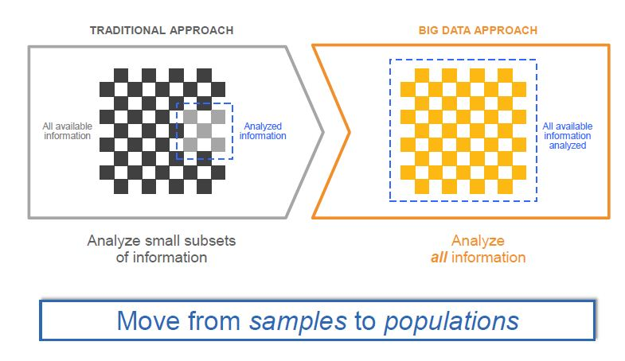

Slide 31
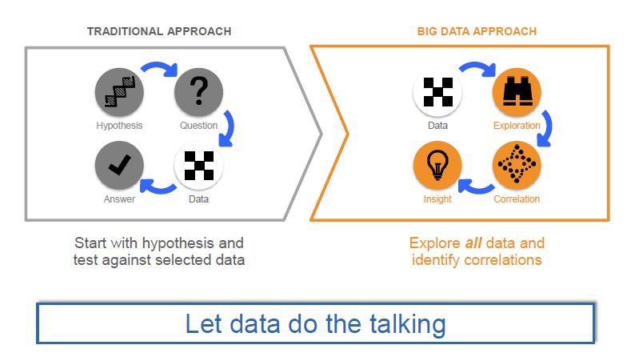

Slide 32
5. Big Data Management tools.
-5.1 Cow story
-5.2 Introduction to Hadoop
-5.3 Basic Working of Hadoop.

Slide 33
5.1 Cow story: Case 1
It is easy for me to handle my resources.(Data).
Data
MB/GB
Storage device

Slide 34
Case 2
I am strong…I can handle my resources
Data
Data
Data
Data
Data
Data
TB
Storage device

Slide 35
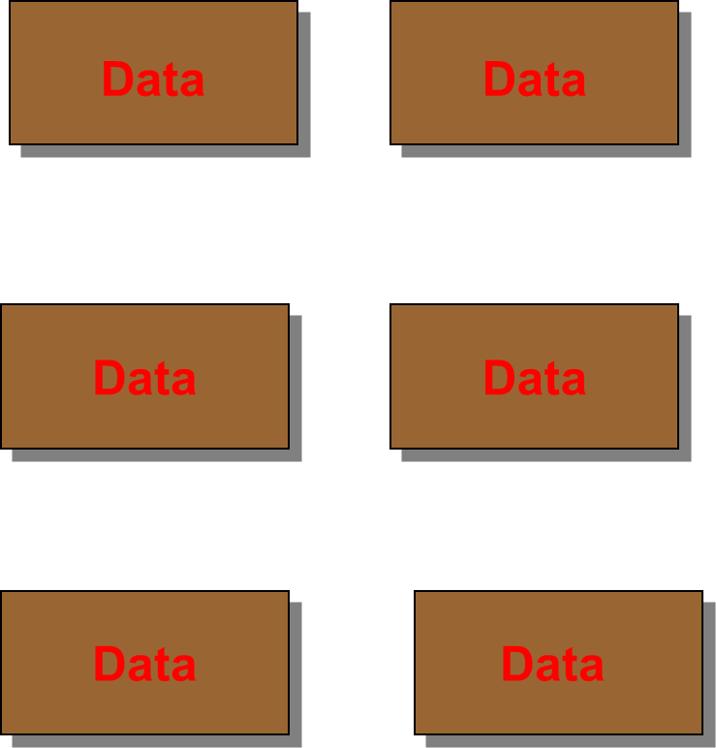
Case 3
Oof…There are so many resources!!!
I am not strong!
Storage device
PB

Slide 36
Case 4
I call my friends for help
Big Data Management tools

Slide 37

5.2 Introduction to Hadoop
Apache Hadoop is an open-source software framework for storage and large-scale processing of data-sets on clusters of commodity hardware.

Slide 38


Introduction to Hadoop
Doug Cutting created the Apache Hadoop.
Logo of Hadoop is a tiny yellow elephant.

Slide 39
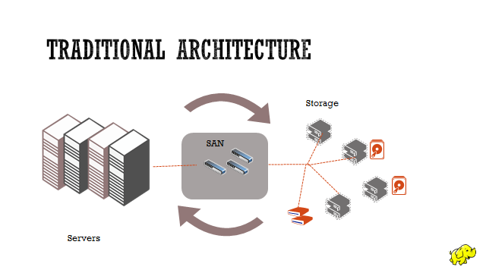
5.3 Basic working of Hadoop

Slide 40
Read 1 TB of Data
1 Machine
10 Machine
4 I/O Channels
Each channel: 100 MB/s
~4.5 Minutes
4 I/O Channels
Each channel: 100 MB/s
~ 45 minutes

Slide 41
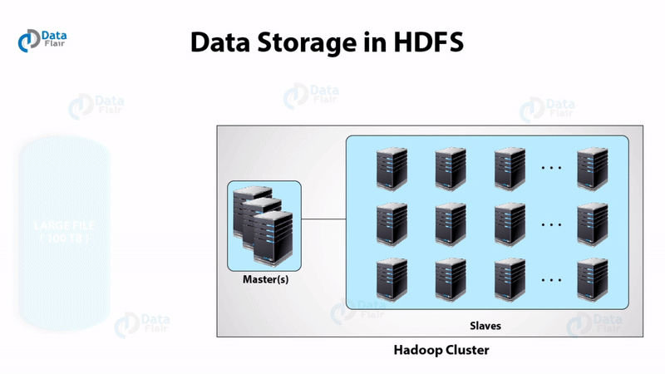
Present Hadoop basic architecture.
Sumber: https://data-flair.training/blogs/how-hadoop-works-internally

Slide 42
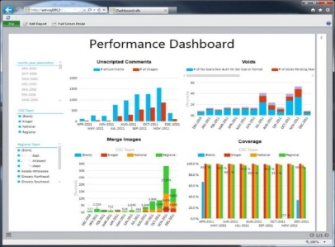
Hadoop is for Big Data.
Application written in java for Big Data Processing
Uses the “Map-Reduce” Processing Paradigm
Optimized for distributed storage and computing of data
Open Source
Very low cost for acquisition and storage
Data
Analytics
Hadoop

Slide 43
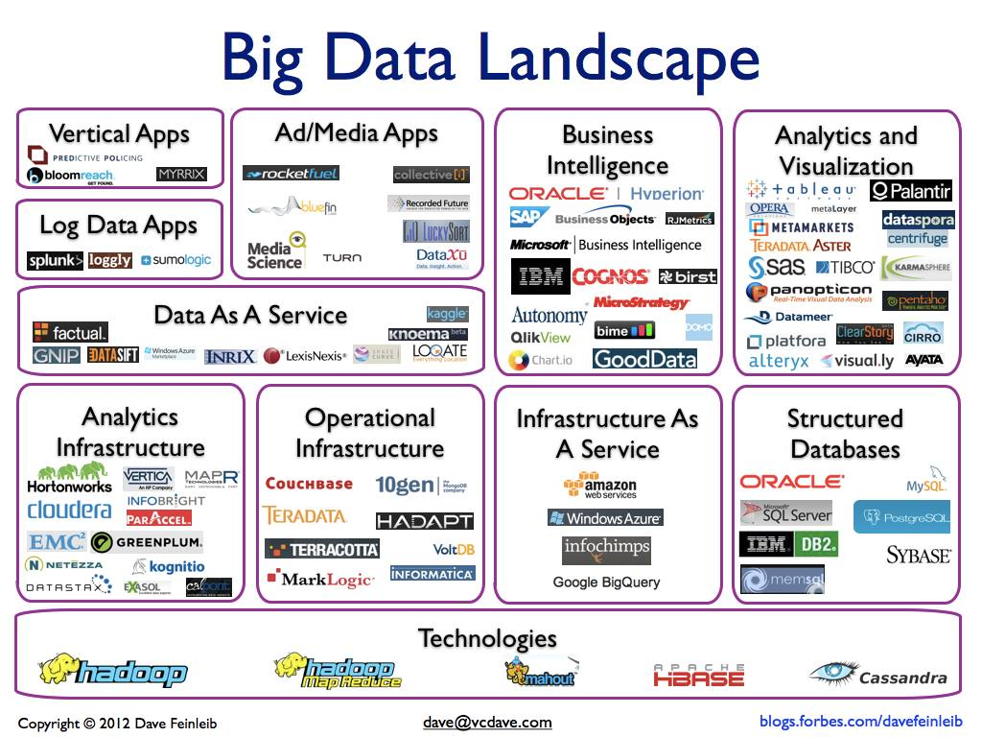
Other big data management tools

Slide 44
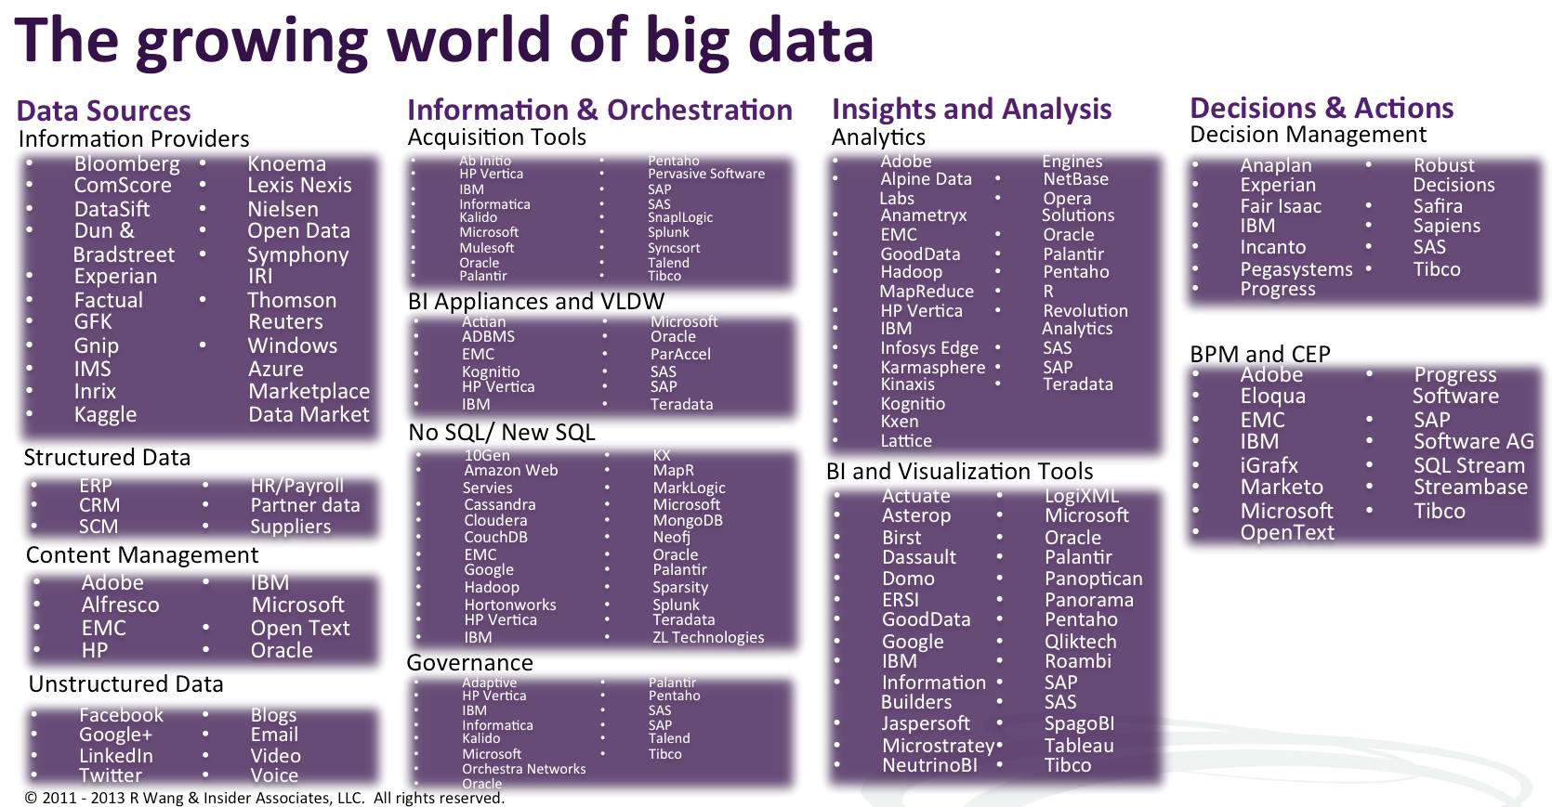

Slide 45
6. Practical Use-Cases
-6.1 Big apps of Big Data tools
-6.2 How big data affects small business
-6.3 Relevance of big data in market

Slide 46
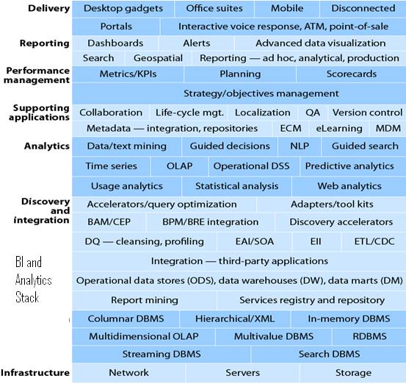
6.1 Big apps of big data tools.

Slide 47
Big data growth
By 2023, the big data industry will be worth an estimated $77 billion, which is roughly 70% of Bill Gates’ net worth.
By 2023 majority of enterprise companies will have their data stored in a public cloud data warehouse, like Snowflake, Amazon Redshift, and Google Big Query.
Sumber: https://www.sigmacomputing.com/blog/top-20-big-data-statistics-for-2020/

Slide 48
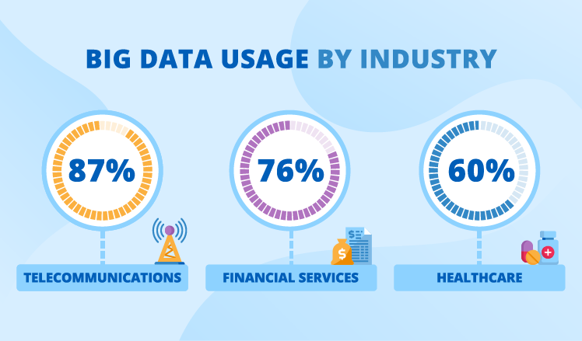
Who is using big data?
Sumber: https://www.scnsoft.com/blog/big-data-use-cases-stats-and-examples

Slide 49
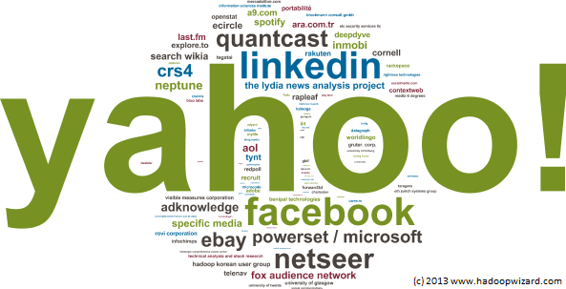
Who is using big data?

Slide 50
6.2 How big data affects small businesses?
Every organization has a tipping point, and most organizations – regardless of size – will eventually reach a point where the volume, variety and velocity of their data will be something that they have to address.
This new big data world is not only about running problems faster, but about solving problems that were not solvable before.

Slide 51

6.3 Relevance of big data in market.

Slide 52
7. Conclusions

Slide 53
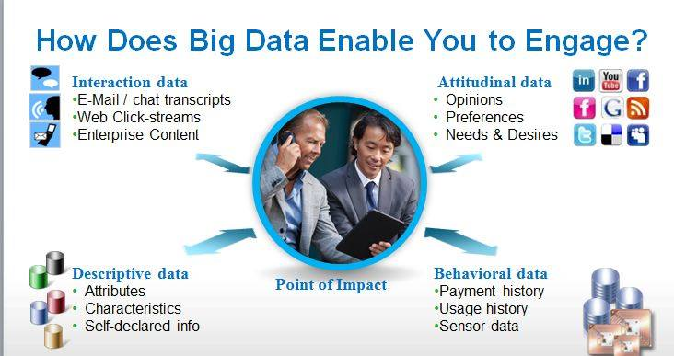
Conclusions: Through pics..

Slide 54
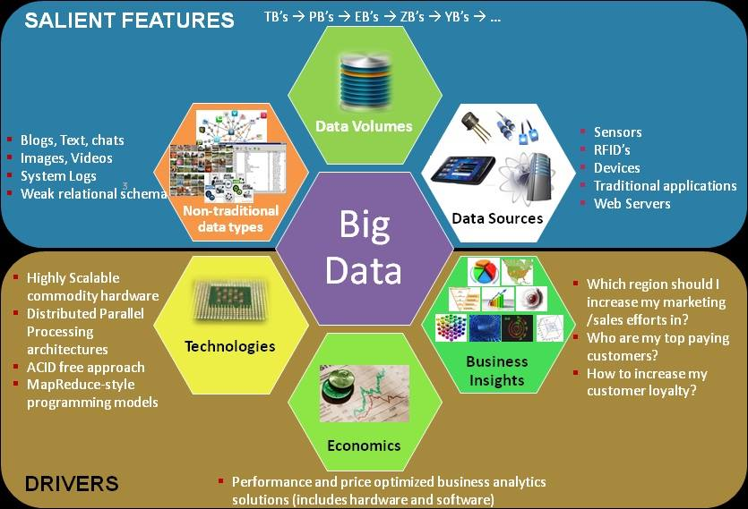
Conclusions: Through pics..

Slide 55
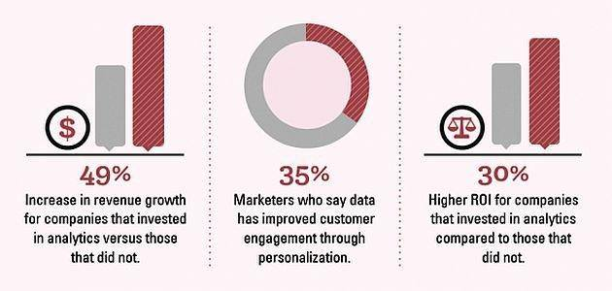
Conclusions: Through pics..

Slide 56
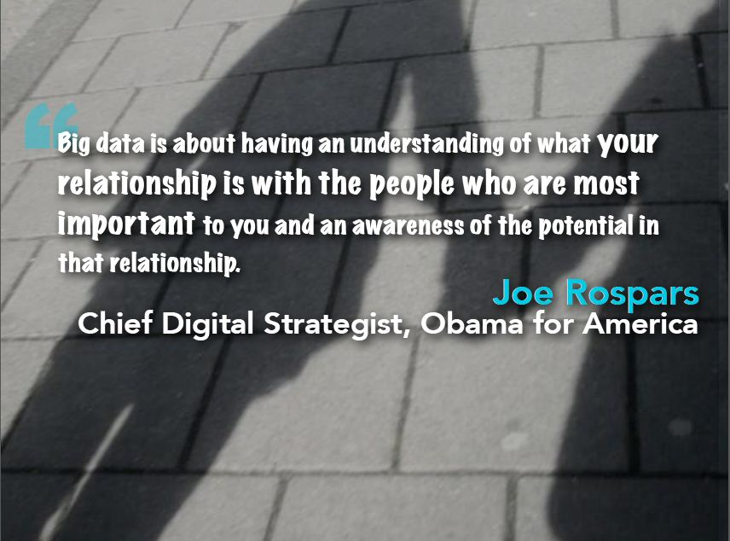

Slide 57
8. References:
www.microsoft.com
http://en.wikipedia.org/wiki/Hadoop
http://en.wikipedia.org/wiki/Big_data
www.google.com
www.slideshare.net
Pdf: Mgkinskey Global Institute
Pdf: 101 Big data by Pradeep Vardan
Workshop in college by ‘Ecsttasys’ on big data

Slide 58
Thank You

